Slide 1
E-retail factors for customer activation and retention: A case study from Indian e-commerce customers
Submitted by Shilpi Mohanty

Slide 2
Things to be discussed
Introduction
Problem Statement
Objective
Exploratory Data Analysis(EDA)
Visualization
Inference
Scope for Future

Slide 3
Introduction
Customer Retension:Customer retention refers to the ability of a company or product to retain its customers over some specified period.
High customer retention means customers of the product or business tend to return to, continue to buy or in some other way not defect to another product or business, or to non-use entirely.
Customer retention measures not only how successful a company is at acquiring new customers but also how successful they are at satisfying existing customers. It also increases ROI, boosts loyalty, and brings in new custom.
Customer satisfaction increases repeat purchases and improves clientele retention for a business.

Slide 4
Benefits of Customer Retention
Cost savings: Customer retention is generally more cost-effective than acquiring first-time customers
Positive word of mouth marketing: Loyal customers are more likely to tell their friends and family about your brand
A better bottom line: Increasing retention rates by just 5 percent can increase revenue by 25 percent to 95 percent
Reducing customer churn
Gaining insight into your customers

Slide 5
Problem Statement
Customer satisfaction has emerged as one of the most important factors that guarantee the success of online store; it has been posited as a key stimulant of purchase, repurchase intentions and customer loyalty.
A comprehensive review of the literature, theories and models have been carried out to propose the models for customer activation and customer retention.
Five major factors that contributed to the success of an e-commerce store have been identified as: service quality, system quality, information quality, trust and net benefit.
The research furthermore investigated the factors that influence the online customers repeat purchase intention. The combination of both utilitarian value and hedonistic values are needed to affect the repeat purchase intention (loyalty) positively.
The data is collected from the Indian online shoppers. Results indicate the e-retail success factors, which are very much critical for customer satisfaction.

Slide 6
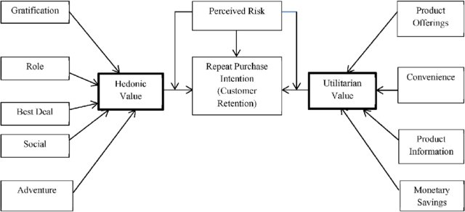
The problem statement can be represented in the form of below use case diagram as well.
Utilitarian Value: It is derived from a product or service that helps the consumer solve problems and accomplish tasks. It can be seen as a means to an end.
Hedonic Value: the immediate gratification that comes from experiencing some activity. With hedonic value, the value received is provided entirely from the actual experience and emotions associated with consumption, not because some other end is or will be accomplished.
Thus we observe from the diagram that both utilitarian value and hedonic value affect repeat purchase intention positively.
Perceived risk affect repeat purchase intention negatively and moderate the effects of utilitarian and hedonic values on repeat purchase intention
Utilitarian value is formed by product offerings, product information, monetary savings and convenience. Hedonic value is formed by the six hedonic benefits namely Adventure,Social,Best Deal,Role,Gratification.
Thus both the utilitarian value and hedonic value are positively associated with buyers' repeat purchase intention.

Slide 7
OBJECTIVE
Objective :To get a deep insight on dataset and find out suitable outcomes, suggestions, conclusion using data analysis that would help to predict customer retention for a e-Retail company using their data on users provided over period of time.
Limitations of the Study
1. The study is confined to E-Commerce sector.
2. Only few firms are covered under the study.
Data Sources and their formats :
The data is collected from the Indian online shoppers. The datasets and figure(s) are highly confidential. The dataset is only available for academic purpose.

Slide 8
Exploratory Data Analysis
Dataset Details:
First, I imported all the necessary libraries to carry out detailed data analysis in Python.
1. Pandas- a library which is used to read the data, visualization and analysis of data.
2. NumPy- used for working with array and various mathematical techniques.
3. Seaborn- visualization tool for plotting different types of plot.
4. Matplotlib- It pro vides an object-oriented API for embedding plots into applications
The dataframe contains 269 rows and 71 columns.
We see all the datatypes are object except the pincode which is integer datatype. If we are heading for building model then the categorical columns needs to be converted to numeric data type
No missing values are present inside the dataset

Slide 9
Dataset details -continues
The data is collected from the Indian online shoppers. Our Dataset consists of reviews and feedbacks of customers on 5 top Indian Online Retailers : Amazon, Flipkart, Snapdeal, Myntra and Paytm.
Dataset focused on service quality, system quality, information quality, trust and net benefit which are the basis of customer retention and customer satisfaction.
Results indicate the e-retail factors based on feedbacks are very much important for customer satisfaction and retention.

Slide 10
Data Visualization
Data visualization is the graphical representation of information and data.
By using visual elements like charts,graphs and maps, data visualization tools provide an accessible way to see and understand trends and patterns in data.
Benefits of Data Visualization: 1)Better Analysis 2)Quick action 3)Identifying patterns 4)Undrtsanding the story 5)Exploring business insights 6)Grasping the latest trend
Different Types of Analysis for Data Visualization are Univariate Analysis: We use a single feature to analyze almost all of its properties. Bivariate Analysis: When we compare the data between exactly 2 features then it is known as bivariate analysis. Multivariate Analysis: In the multivariate analysis, we will be comparing more than 2 variables.
I have used here Univariate and Bivariate Analysis.

Slide 11
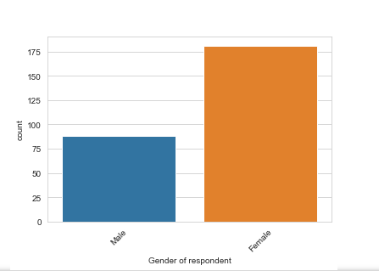
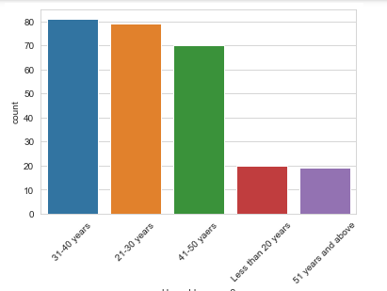
Univariate Analysis
I have used seaborn countplot (sns.countplot function) which creates bar charts of the number of observations per category. When we use sns.countplot, Seaborn literally counts the number of observations per category for a categorical variable, and displays the results as a bar chart.
Examples as gender of respondent, thus we see that female respondent are more comparison to male.
Another example age group: We see that age group range from 31-40 years are more dominating due to fact that they are working class people followed by 21-30years .
Similarly others features were also analyzed.

Slide 12
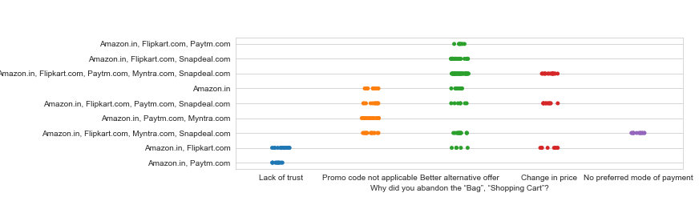
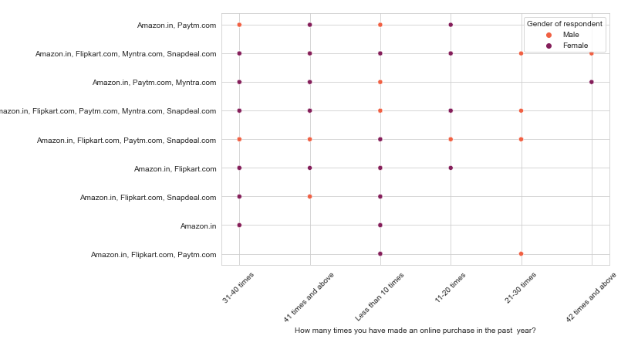
Bivariate Analysis
I have used stripplot for bivariate analysis. we see that flipkart,amazon and paytm customers abondon the bag/shopping cart due to better alternative offer or promo code not applicable.So this can result in mistrust.So we need to retain the customers by introducing some cashback/offers.
Another example: Thus we can see that woman respondent are more interested for repeat purchase than men respondent. They have been doing repeat purchase for more than 31-40 times from all the retailers. some of the woman respondent who shop for 21-30 times and 11-20 times a year seem to exclude myntra.

Slide 13
Feedback Analysis
Now I have divide positive feedback and negative feedback into separate dataframe and analyse the same based on different retailers.
We can see that after column 47, there are both positive and negative feedbacks of the websites, which are given by the respondents. We have assessed those data by using iloc function.
The shape of positive feedback is 269 rows and 17 columns and rest are negative feedback.
I have used pie-plot to analyse the positive feedback and negative feedback.

Slide 14
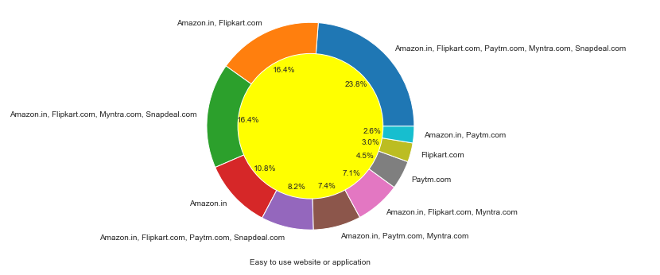
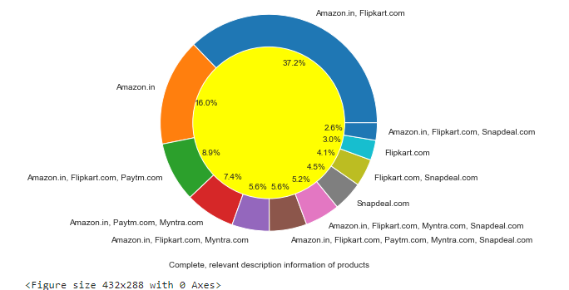
Positive Feedback Example
Considering all the positive feedback analysis, We see that Amazon, Flipkart scored the highest votes for having all the positive points and have maintained a very good brand image followed by paytm and the myntra.

Slide 15
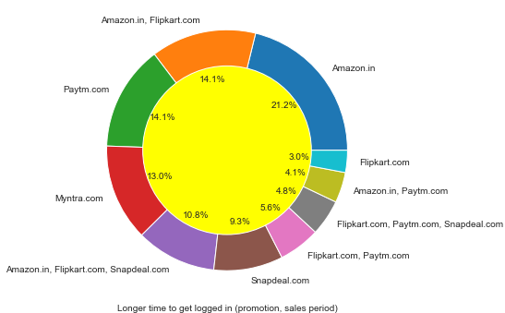
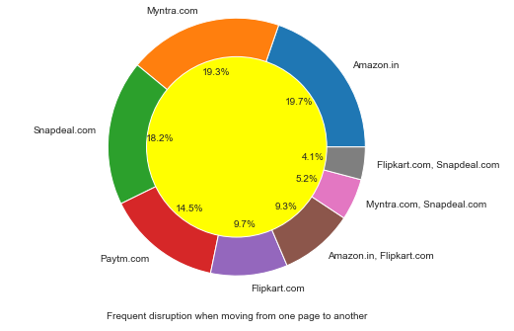
Negative Feedback Example
Respondnets have voted 19.7% to amazon followed by 19.3% to Myntra and Snapdeal at 18.2% for frequent disruption when moving from one page to another.
Respondents have voted 21.2 % to Amazon for longer time to get logged in followed by Paytm.
Thus we see many people have voted negative for top brands like amazon,paytm being loyal to them.

Slide 16
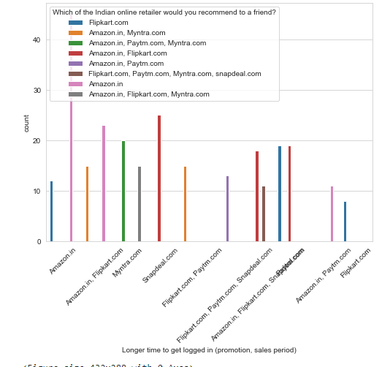
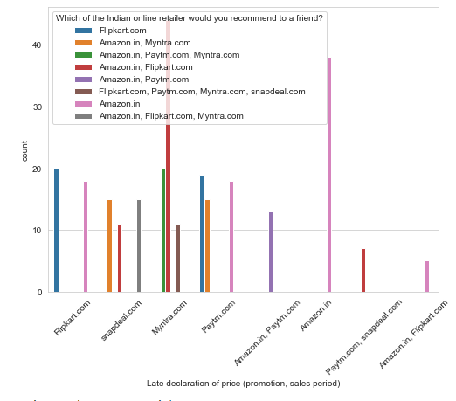
Brand Recommendation
I have also used countplot based on the respondent recommendation to their friend.
Customers seem to be more loyal to amazon, flipkart and paytm as even though many of them have given negative remarks about them still they would prefer and recommend these platforms to their friend

Slide 17
Inference
Based on overall observations the first 47 features provide insights on how e-retail is expanding and helpful based on customer remarks. The data explained how the online platform has been used more often in which city,age,gender etc. .It shows which are the strengths,weakness,opportunity and threats to the e-retail busiines and e-retailers has to take measures to improve upon it.It shows which factors are considered the significant for retaining the existing customers and acquiring the new customers.
Based on the case study for customer activation and retention, Amazon is the most reliable and has been fulfilled all the customer requirements. After Amazon the data showed Flipkart has been used more for online shopping.
The case study from Indian e-commerce customers showed Amazon and Flipkart has been used mostly for Online Shopping and most recommended by Friends. So based on the research factors Amazon and Flipkart are the e-commerce platform which are having the combination of both utilitarian and hedonistic values to keep the repeat purchase intention (loyalty) positively.

Slide 18
Recommendation and Suggestion 1.AMAZON.COM
Suggestion for improvement
Positive feedback summary:
a)Load Time for website & longer time for displaying graphics: The faster the website's load time is, the happier the customers/visitors will be. when we optimize the web page's load time, then we can expect to see improvements in user experience (UX),conversion rates, and ultimately, sales revenue.So there are online tools available which allow to test website’s page speed timely and necessary steps can be taken as website load times impact conversion rates and, as a result, the business as a whole.
b)There should be timely declaration of price during promotion/sales else in no time customers can switch to other brands. Remember if you don’t promote it properly in time, you’re likely to miss out on opportunities.
c)Reduce the delivery time of the products: Fast and affordable shipping options is a must. By implementing a distributed inventory model, retailers can easily reduce shipping costs and transit times in order to meet customer expectations.
d)Finding ways to offer free shipping has been proven to improve sales conversations and reduce cart abandonment.
Easy to use website/application.
wide variety of product offering.
complete and relevant description of product,
reliability of website and perceived trust worthiness,
several payment options and enhanced security
Fast delivery of products.
Presence of online assistance through multi-channels

Slide 19
2. Flipkart.com
Suggestion for improvement
Positive feedback summary
a)Load time for website and longer time for displaying graphics should be decreased as explained above.
b)Declaration of prices during sales promotion should be timely and not hidden as customers will take no time to switch to other brands. Retailer can also introduce introductory price offer on releasing new product
c)Availability of more payment options to customers as this will give customers wider options for payment.
d)Reduce the delivery time of the products by improving logistic .
Easy to use website/application.
wide variety of product offering.
complete and relevant description of product,
reliability of website and perceived trust worthiness,
several payment options and enhanced security
Fast delivery of products.
Presence of online assistance through multi-channels
Wide variety of products to offer.

Slide 20
3. Myntra.com
Suggestion for improvement
Positive feedback summary
1)Longer page loading :Retailers should try to improve website loading speed by checking with online tools available and optimise the webpage speed.
2)Frequent disruption when moving from one page to another :This can cause users to bounce or leave the site and drops cu customer base massively.
3)Declaration of price should be upfront and in time
Convenient and a good website.
Availability of several payment options.
Faster products delivery.
Complete information of products available.
Reliable website or app, perceived trustworthiness and good Security.
Wide variety of product to offer

Slide 21
4. Paytm.com
Suggestion for improvement
Positive feedback summary
Reduce the delivery time of the products during promotions by introducing variety of delivery options like same day delivery, two day delivery and choosing a good logistic company.They can also offer free delivery.
2.Retailers should avoid late declaration of prises and may follow by introducing early Bird Pricing Strategy .Early bird pricing provides savings for attendees who are willing to shop your products early, sometimes even before plans are finalized.
3.Website page loading and longer time to display graphics should be improved and taken care of.
4.Frequent disturbance is occurring while moving from one page to another
Convenient to use and a good website
Quickness to complete a purchase.
customers feel that either web or app is reliable.
wild variety of products on offer.
Reliability

Slide 22
5. Snapdeal.com
Suggestion For Improvement
Positive feedback summary:
Reduce the delivery time of the products during promotions as expalined above.
2)Avoid giving late declaration of prices.
3)Website page loading should be improved
4)Longer delivery period should be curtailed and improved.
5)No one has expressed to recommend snapdeal to a contact as it has the most negative feedbacks among all other websites
Convenient to use.
financial information security.
Presence of online assistance through multi-channels

Slide 23
Recommendations for e-commerce websites
E-commerce retailers may look on these parameters for improvement of their products/services which can retain their customers and attract new customers.
Information Quality: Improve e-commerce website design by optimise the product imagery, enable your customers to easily find what they need, ensure the product information is accurate, include customer remarks.
service quality: Excellence in service quality include personalized service, good return policies, complaints desks and hotlines, responsiveness. We need to take care of it as customer is king. The core task of a business is to ensure that customers come back, which can be done by delivering excellent service quality. Personalized service is a key way to retain customers, because you show them that they are more than just a source of income to you
system quality: There should not be errors in the website pages, slow loading pages as web shoppers have become more sophisticated in the knowledge of online purchasing alternatives, and more importantly, they have become less patience in with websites that are difficult to understand and used. Users expect to process the information efficiently and with little effort. Ecommerce website if ignores these facts may face risk in losing the valuable customers base. There is also the need to provide quality services free of interruptions and hindrances.
Trust : It is key factor for any retailers .If trust is there ,then the customers will repurchase a particular product or set of products in a routinized or habitual fashion.
Net benefit: Web shopping provides with the opportunity to reach more and new customers and retaining the existing ones by introducing schemes like discount offers, special deals, early bird price strategies, by inviting them to special trial for personalised experience, by giving them cashback etc
Majority of the customers are working class women and their age is between 20-40. Always bring variety of products targeting them.
Provide more customer friendly approach like fast delivery, complaint resolution, etc.

Slide 24
Future Scope
We recommended some suggestions for the websites to improve further in the future by analysing the dataset by using data analysis approach. We can further build models like classification models e.g Random forest classifier,Adaboost classifier,Descission Tree Classifier etc to predict the accuracy of brand recommendation by customers as the target variable and can do hyper tuning through GridsearchCV and simultaneously can do features importance.

Slide 25
THANK YOU

